Slide 1
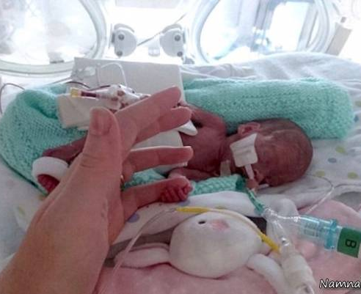
History of Pulmonary Surfactant Replacement Therapy for Neonatal Respiratory Distress Syndrome
Ala Shamsi

Slide 2
The history of PS research in the age of pre-clinical trials
In 1929, Von Neergaard1 studied pulmonary surfactant function in the porcine lung and demonstrated that a lower surface tension would be useful for the respiratory mechanism.
In 1946, Thannhauser et al. 2 showed that the lung contains unusually large amounts of dipalmitoylphosphatidylcholine (DPPC); however, at the time, the association between DPPC and the surface-active properties of the alveolar wall was not known.
In 1947, Gruenwald 3 reported that resistance to aeration is caused by surface tension interfering with the entrance of the air, and surface-active substances were shown to reduce the pressure required for lung aeration.
In the 1950s, Clements4 and Macklin5 experimentally demonstrated that PS influences the ST in lung volume.
1.Neergaard K. Neue auffassungen über einen grundbegriff der atemmechanik. Z Gesamte Exp Med. 1929;66(1):373–394.
2. Thannhauser SJ, Penotti J, Boncoddo NF. Isolation and properties of hydrolecithin (dipalmityl lecithin) from lung; its occurrence in the sphingomyelin fraction of animal tissues. J Biol Chem. 1946;166(2):669–675.
3. Gruenwald P. Surface tension as a factor in the resistance of neonatal lungs to aeration. Am J Obstet Gynecol. 1947;53(6):996–1007.
4. Clements JA. Dependence of pressure-volume characteristics of lungs on intrinsic surface active material. Am J Physiol. 1956;187:592.
5. MacKlin CC. The pulmonary alveolar mucoid film and the pneumonocytes. Lancet. 1954;266(6822):1099–1104.

Slide 3
In 1959, after Avery and Mead1 discovered that the pathophysiology of neonatal respiratory distress syndrome (RDS) involved the insufficient production of pulmonary surfactant (PS) in premature infants, “hyaline membrane disease”—the former name of the disease—was replaced by RDS. 6
6. Avery ME, Mead J. Surface properties in relation to atelectasis and hyaline membrane disease. AMA J Dis Child. 1959;97(5, Part 1):517–523.

Slide 4
In 1980, Fujiwara et al.7 performed treatment via the respiratory tract in 10 pediatric patients with RDS, using Surfactant (an artificial pulmonary surfactant that was extracted from bovine lung.
7. Fujiwara T, Maeta H, Chida S, Morita T, Watabe Y, Abe T. Artificial surfactant therapy in hyaline-membrane disease. Lancet. 1980;1(8159):55–59.
In fact, it has contributed significantly to the reduction in RDS mortality in the past 30 years, and to the improvement of neonatal, perinatal, and infant mortality rates.8,9
This was the first successful treatment using artificial PS supplementation in humans, and has since resulted in improvement in oxygenation, treatment progress, and prognosis.
8. Obladen M. History of surfactant up to 1980. Biol Neonate. 2005;87(4):308–316.
9. Halliday HL. Surfactants: past, present and future. J Perinatol. 2008;28(Suppl 1):S47–S56.

Slide 5
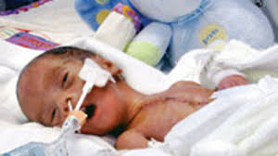
Surfacten® since 1991
Exosurf® (generic names as colfosceril palmitate, hexadecanol, and tyloxapol, Wellcome Foundation Ltd., London, UK) since 1991
Newfactan® (Yuhan Corporation, Seoul, Korea) was developed in Korea and has been used since 1996
Curosurf® (generic name as poractant alfa, Chiesi Farmaceutici, Parma, Italy) since 2003,
and Infasurf® (generic name as calfactant, Onybiotech, New York, NY, USA) since 2007.10
10. Bae CW. The history of neonatology in. J Korean Med Assoc. 2016;59(7):490–497.

Slide 6
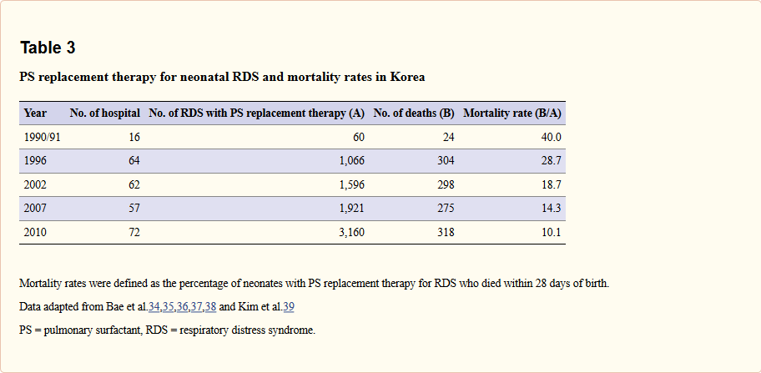
History of Pulmonary Surfactant Replacement Therapy for Neonatal Respiratory Distress Syndrome in Korea
Chong-Woo Bae, Chae Young Kim, Sung-Hoon Chung, and Yong-Sung Choi
Journal of Korean Medical Science, 2019 Jul 1; 34(25): e175.

Slide 7
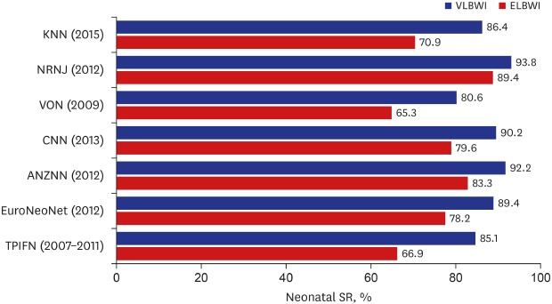
Comparison of the neonatal SRs of VLBWI and ELBWI between Korea, Japan, US, Canada, Europe, Australia and New Zealand, and Taiwan. Data adapted from Chung et al.11
SR = survival rate, VLBWI = very low birth weight infants, ELBWI = extremely low birth weight infants, KNN = Korean Neonatal Network, NRNJ = Neonatal Research Network of Japan, VON = Vermont Oxford Network; CNN = Canadian Neonatal Network, ANZNN = Australian and New Zealand Neonatal Network, EuroNeoNet = European Neonatal Network, TPIFN = Taiwan Premature Infant Follow-up Network.
11. Chung SH, Bae CW. Improvement in the survival rates of very low birth weight infants after the establishment of the Korean neonatal network: comparison between the 2000s and 2010s. J Korean Med Sci. 2017;32(8):1228–1234.

Slide 8
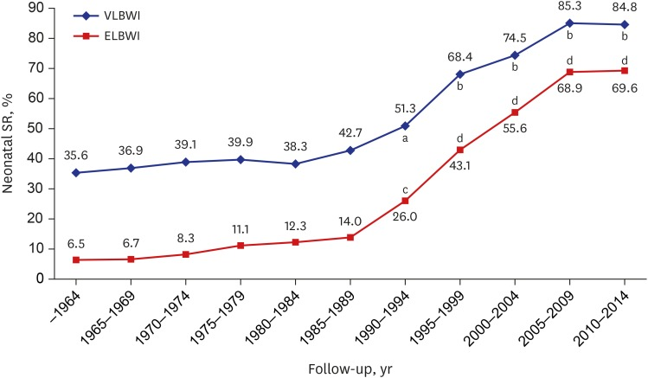
Changes of neonatal SRs for VLBWI and ELBWI in Korea (1960–2014.6). Data adapted from Shim et al.12
SR = survival rate, ELBWI = extremely low birth weight infants, VLBWI = very low birth weight infants.
12.Shim JW, Jin HS, Bae CW. Changes in survival rate for very-low-birth-weight infants in Korea: comparison with other countries. J Korean Med Sci. 2015;30(Suppl 1):S25–S34.

Slide 9
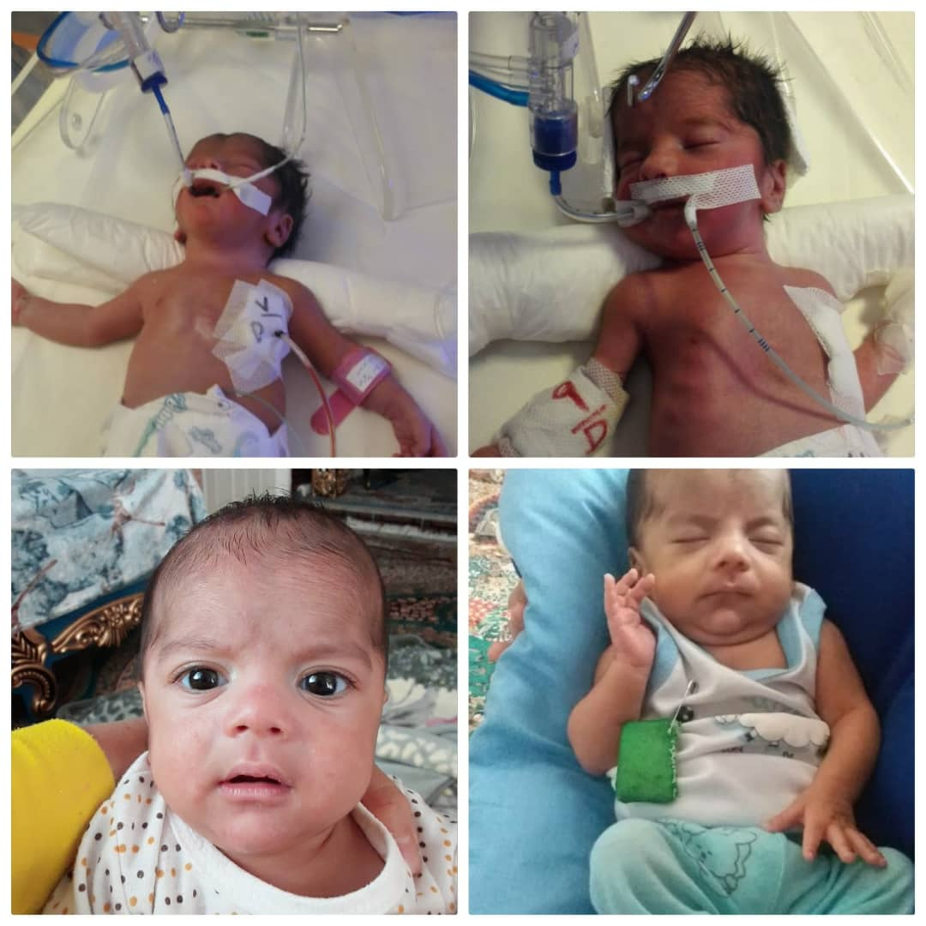

Slide 10


Slide 11
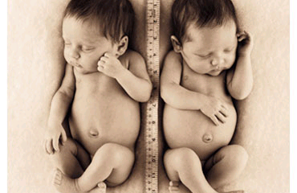
Thanks for your attention

